Slide 1
Anime Dataset Analysis
2018 CSC 1023
Tarun Luthra

Slide 2
Packages Used
Tidyverse – for ggplot
Plotly – for plotting
Formattable – for tables

Slide 3
Data
Let’s take a look at the data. We have two files:
anime.csv: This refers to the shows.
rating.csv: This refers to the 76,000 user ratings.

Slide 4
Anime Table – Head(8)
anime_id | name | genre | type | episodes | rating | members
32281 | Kimi no Na wa. | Drama, Romance, School, Supernatural | Movie | 1 | 9.37 | 200630
5114 | Fullmetal Alchemist: Brotherhood | Action, Adventure, Drama, Fantasy, Magic, Military, Shounen | TV | 64 | 9.26 | 793665
28977 | Gintama° | Action, Comedy, Historical, Parody, Samurai, Sci-Fi, Shounen | TV | 51 | 9.25 | 114262
9253 | Steins;Gate | Sci-Fi, Thriller | TV | 24 | 9.17 | 673572
9969 | Gintama&#039; | Action, Comedy, Historical, Parody, Samurai, Sci-Fi, Shounen | TV | 51 | 9.16 | 151266
32935 | Haikyuu!!: Karasuno Koukou VS Shiratorizawa Gakuen Koukou | Comedy, Drama, School, Shounen, Sports | TV | 10 | 9.15 | 93351
11061 | Hunter x Hunter (2011) | Action, Adventure, Shounen, Super Power | TV | 148 | 9.13 | 425855
820 | Ginga Eiyuu Densetsu | Drama, Military, Sci-Fi, Space | OVA | 110 | 9.11 | 80679

Slide 5
Ratings Table – Head(10)
user_id | anime_id | rating
<dbl> | <dbl> | <dbl>
1 | 20 | -1
1 | 24 | -1
1 | 79 | -1
1 | 226 | -1
1 | 241 | -1
1 | 355 | -1
1 | 356 | -1
1 | 442 | -1
1 | 487 | -1
1 | 846 | -1

Slide 6
Ratings Frequencies
 | rating | ratings | people
 | <dbl> | <int> | <int>
1 | -1 | 1476496 | 37128
2 | 1 | 16649 | 6038
3 | 2 | 23150 | 8486
4 | 3 | 41453 | 11828
5 | 4 | 104291 | 21788
6 | 5 | 282806 | 34554
7 | 6 | 637775 | 46396
8 | 7 | 1375287 | 55881
9 | 8 | 1646019 | 60462
10 | 9 | 1254096 | 62164
11 | 10 | 955715 | 62029

Slide 7
Analysis
So what are some questions we can ask?
Are ratings consistent across genres?
Are ratings consistent across the number of episodes?
Do more episodes lead to a higher or lower average rating?
How does popularity relate to the number of episodes?
Do individuals rating on the same scale, or different scales?
How many people rate an anime, versus watch it? Does it depend on genre?
Can we identify sequels in the anime table?
How do ratings vary by type (e.g. movie, TV, Special, OVA, etc)
Let's answer these one by one.

Slide 8
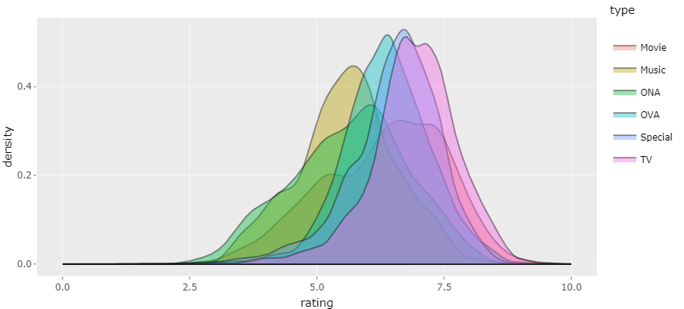
How do ratings vary by anime type?

Slide 9
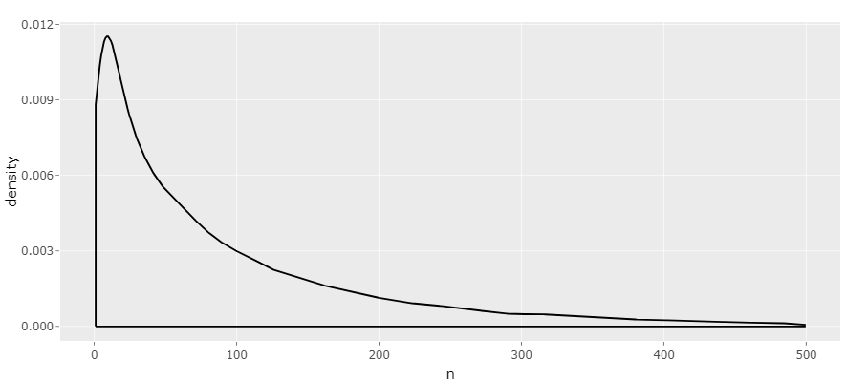
How many animes do people rate?

Slide 10
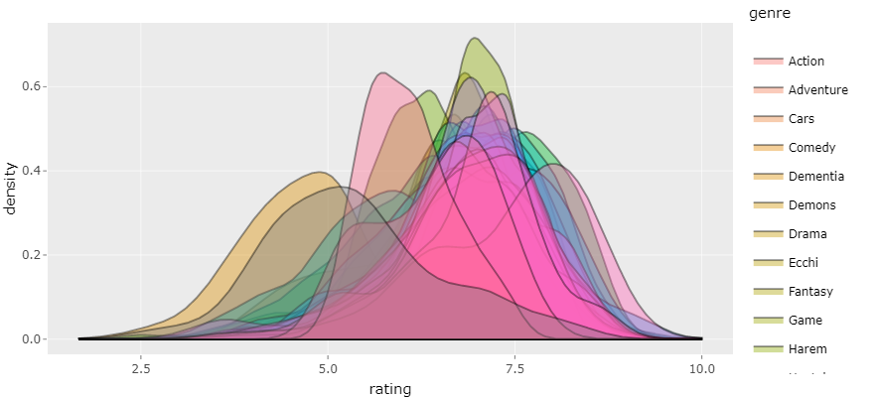
Are ratings consistent across genres?

Slide 11
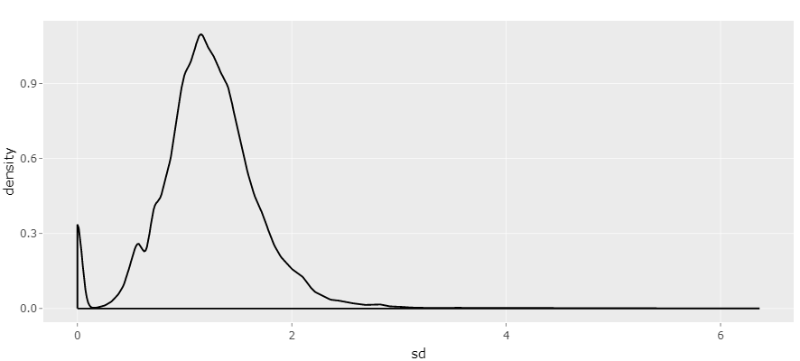
Do people rate consistently?

Slide 12
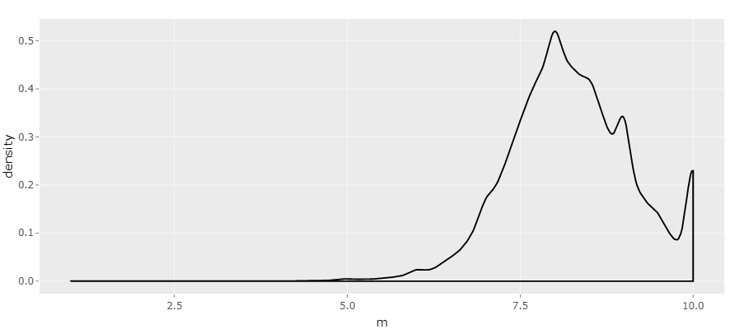
What about the actual ratings?

Slide 13
How do ratings vary by number of episodes?
Let’s take a look at average number of episodes by genre.
 | type | average.episodes | sd.episodes | average.rating | sd.rating
 | <chr> | <dbl> | <dbl> | <dbl> | <dbl>
1 | Movie | 1.102389 | 2.149296 | 6.318476 | 1.2120871
2 | Music | 1.131417 | 1.293852 | 5.588665 | 0.9593978
3 | ONA | 6.877651 | 11.382952 | 5.633066 | 1.1281090
4 | OVA | 2.417663 | 3.208938 | 6.370896 | 0.8594610
5 | Special | 2.561341 | 3.700094 | 6.525828 | 0.8840049
6 | TV | 35.915595 | 80.640355 | 6.929143 | 0.8308088

Slide 14
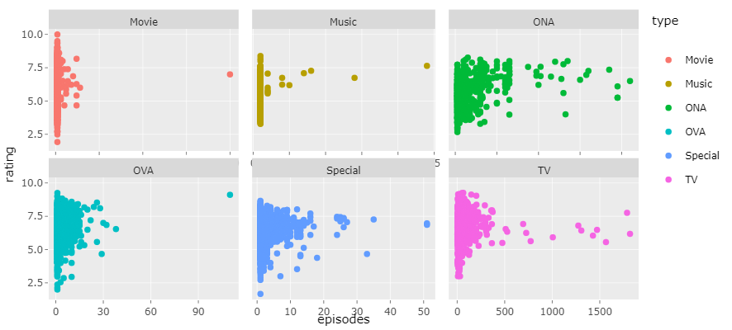

Slide 15
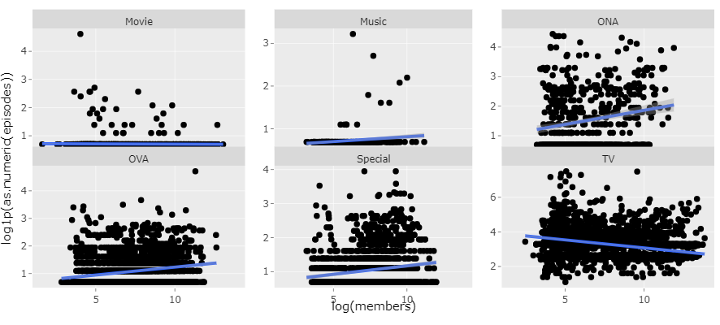
Episodes VS Members

Slide 16
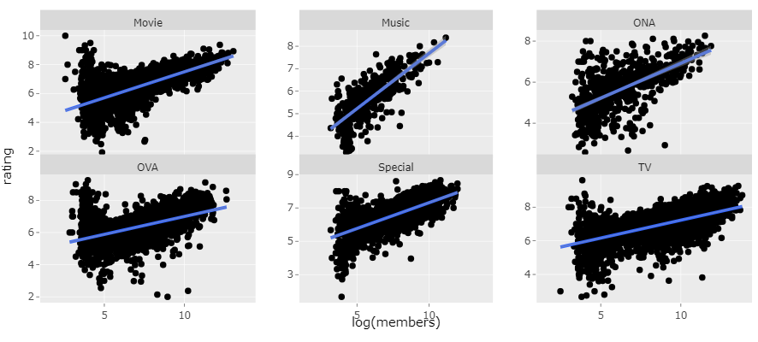
Rating VS Members

